Slide 1
ITLG311 - Business Communication
Faculty of ICT, Mahidol University
Semester 1, 2026/2027
Session 01: Getting Started
UNIT 1: WHAT IS BUSINESS COMMUNICATION?

Slide 2
Course Resources:
MyCourses:
Course Information
Supplementary Resources
Quizzes
Assessment Instructions
Assessment Submission Points

Slide 3
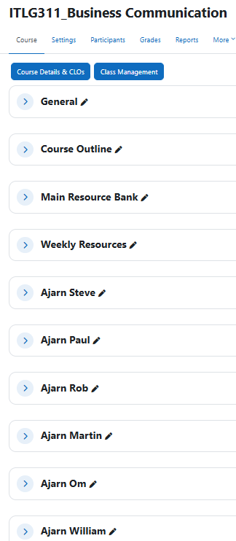
Getting Started:

Slide 4
Today:
Understand the purpose and goals of the course
Understand Lesson structures, Activities & Evaluations
Recognize fundamental aspects of Business Communication
Recognizing the audience and adapting communicative needs

Slide 5
Class Expectations
Attendance 80% required ! Less than 80% = no final exam Be on time! > 20 mins = late >30 mins = absent | Preparation Laptop or tablet. (Not phone!) MyCourses, Google Drive English to English Dictionary Textbook Paper and pens
Sick or Absent Email Instructor. It is your responsibility to follow up on any missing information, materials, and assignments. Do not forget to do the make-up work! | Be an Active Learner Manage your self and your time! No social media, chat apps, or games No Chat-GPT or AI work Engage with your materials. Question. Analyze. Learn. Have an opinion.

Slide 6
Getting Started:
What IS Business Communication?
What are common business situations that require effective communications?
How can we define ‘good communication’?
Why is good communication important for Business situations?
What is the purpose of communication?
Who or What do you think is the (business) audience?
What do you think you will learn in this course?
Notes:
Use this as a jumping off point
Following slides answer each question in further detail

Slide 7

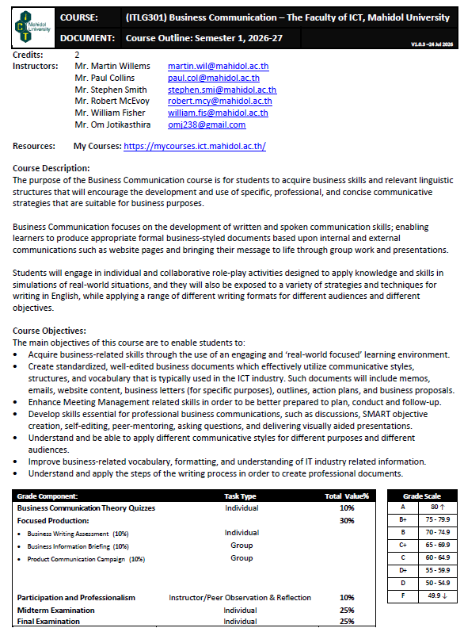
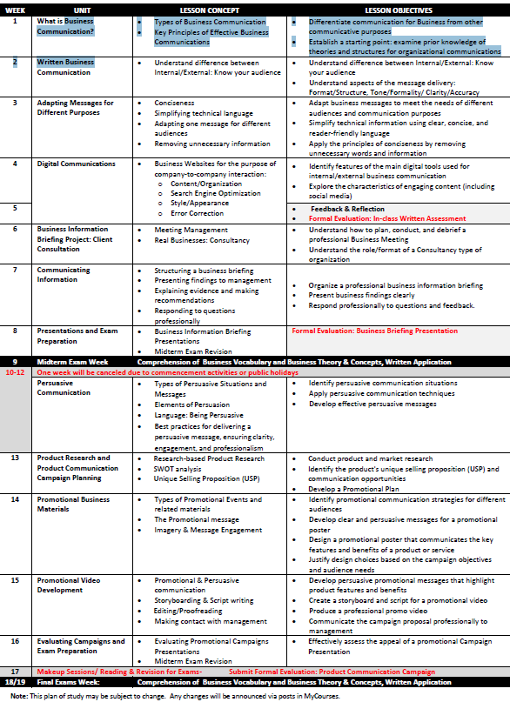
In this course you will…
Notes:
Refer to Syllabus

Slide 8
Questions so far?

Slide 9
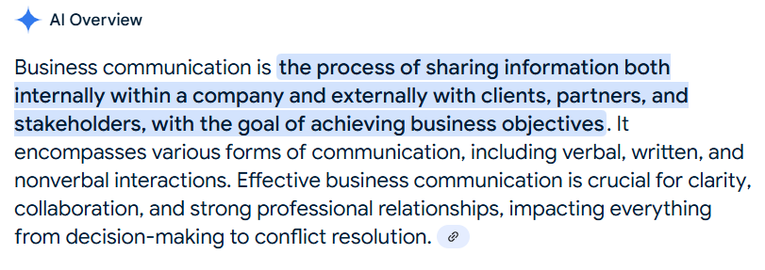
What IS Business Communication?
Notes:
Maybe highlight the words internally and externally.
Also link effective communication to improved clarity, collaboration and stronger relationships in the workplace

Slide 10
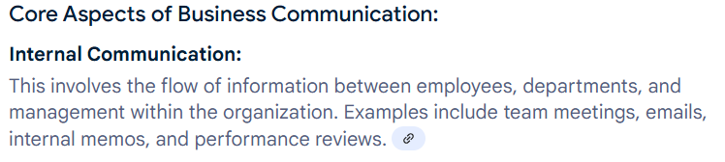
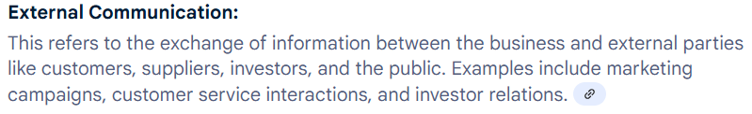
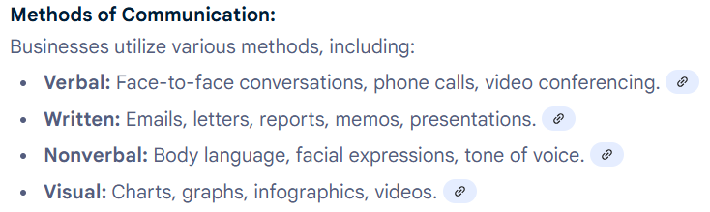
What IS Business Communication?

Slide 11
Common Business Situations:
Q: What are some examples of business situations that require effective communication that you can think of?
Tip: think Internal and External
Notes:
List as many as you can think of…..
Formats:
Face to Face/Email/Formal Business Meetings/Social Media/Team Messaging
Functions:
Requesting/Providing – information or tangible objects
Complaining/Apologizing – quality of standards/service/experience
Replying: confirmation or acceptance/rejection
Main Message:
Informational
Instructional
Persuasive
Transactional
Situations Include:
Reporting a software bug
Responding to a customer inquiry
Responding to a customer complaint
Requesting technical support
Announcing scheduled system maintenance
Providing a project progress update
Scheduling or inviting colleagues to a meeting
Explaining a technical issue to a client Requesting information or clarification
Giving instructions or assigning tasks
Reporting a cybersecurity or system incident
Requesting approval for a project or purchase
Sharing meeting minutes or decisions
Explaining a project delay or unexpected problem

Slide 12
Good Communication
Good Communication is a key to success:
Communication is a two-way process focused on
Expressing your ideas clearly and precisely
Listening to, and understanding ideas of others
Responding with feedback, and sharing ideas
Communication is affected by:
The source, the message, the channel used, the environment, and the context
Interference: anything that blocks or changes the message
Language: language itself can be an obstacle to communication

Slide 13
Good Writing
Most of your communication in this course will be written communication
Good Business Writing:
Follows ‘rules’: grammar, norms, expectations
Is easy to read
Serves a purpose and attracts the audience
Consider:
Clarity, Conciseness, Arrangement, Credibility, Expectations, References, Tone, Emphasis and Engagement
Remember: Writing that does not meet this criteria will not be effective writing

Slide 14
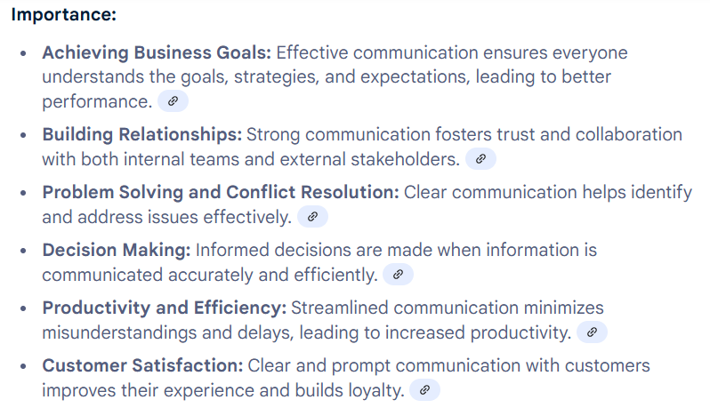
Why is Business Communication important?
What is its purpose?

Slide 15
The Audience
Knowing and understanding your audience will help you communicate effectively
Consider:
Who is the audience?
How large is the audience?
What are the backgrounds, genders, ages, jobs, education level and interests?
What do you think the audience already knows?
What do you think the audience needs to know?
What communication channel/method/platform will best reach the audience?

Slide 16
Types of Business Communication Methods/Platforms:
Q: How many types of methods/platforms for business communication can you identify?
Notes:
List as many as possible known media/platforms
General Written Communication
Email/Memo
TV
Advertising
Telephone Calls
Chat/Messaging Apps
Meeting Management
Social Media – Twitter/X, Facebook, LinkedIn, Instagram
Slack
MS Teams
Websites
Posters, Brochures, Leaflets
See next pages for list and clear focus

Slide 17
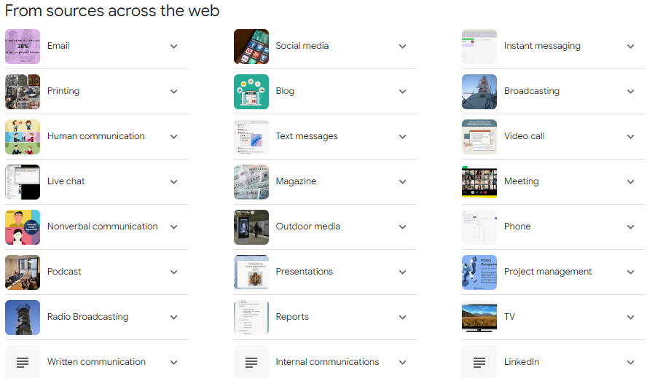
Different Methods/Platforms for communications:
We are mostly interested in:
Email
Meetings
Business Information and Updates
Proposal Presentations
(Short) Progress Reports
Instant Messaging
Social Media
AI-assisted Business Communication

Slide 18
Choosing the Best Communication Method
Work with a partner. For each situation below, decide:
Who is the audience?
What is the purpose?
What is the best communication method?
A software update has introduced a serious security bug affecting all customers.
A customer reports that they were charged twice for an online payment.
Your project team needs to decide which programming framework to use for a new mobile application.
Management requests a summary of this month's IT Helpdesk performance, including graphs and recommendations.
Your company is launching a new AI feature and needs to announce it to customers before release.
Do you think everyone would choose the same communication methods? Why/ Why not?

Slide 19
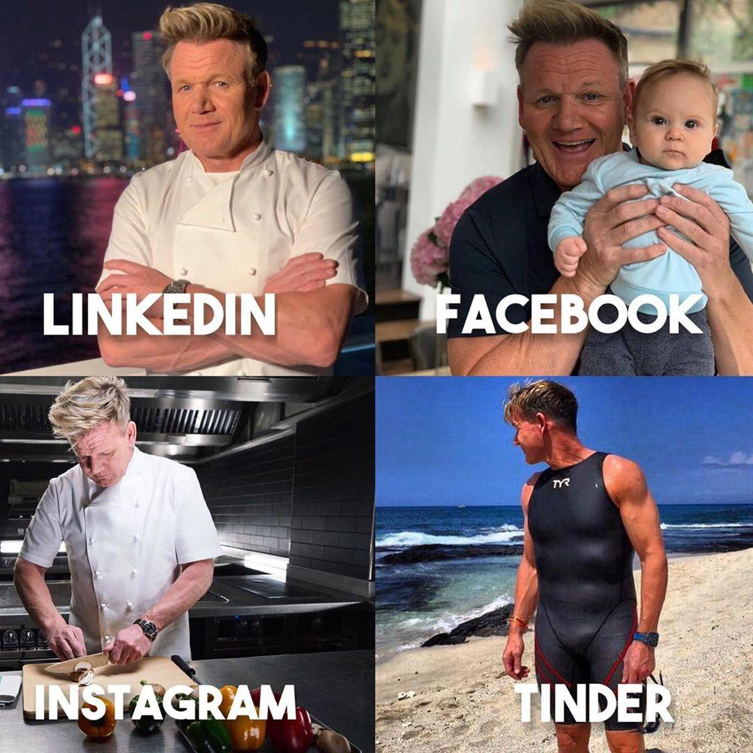
Different Audiences & Different Purposes
WHAT you communicate
HOW you communicate
are influenced by your audience and purpose
Task: How would you describe yourself in writing for difference audiences and purposes?
Brainstorm and create a description that represents your:
knowledge and special skills
personality/ethics/values
goals/objectives/motivation
for three or more different audiences/purposes

Slide 20
Reflection:
Self Reflection:
What did you write?
How did you write?
What influenced the decisions you made about what to write?
Peer Reflections:
Share your writing with another student - evaluate:
What is your impression of the student you are reading about?
Did the student write distinctively different ideas for different audiences/purposes?
What were some of the differences you noticed?
Do you have any comments or suggestions?

Slide 21
BREAK TIME

Slide 22
Vocabulary/Phrasing: Why Does It Matter?
Understanding vocabulary and common phrases are critical to your success in:
Understanding what other people are communicating to you
Recognizing and anticipating how others will understand what you are communicating to them
In the workplace, the words you choose affect how people respond to you.
Business Vocabulary is different from day-to-day vocabulary.
Understanding business vocabulary helps you to:
Understand instructions, emails, meetings, and reports.
Communicate your ideas clearly and professionally.
Choose language that matches your audience and purpose.
Avoid misunderstandings that can lead to mistakes or delays.

Slide 23
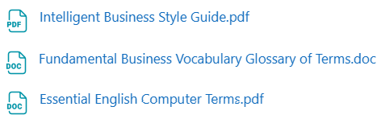
Vocabulary/Phrasing
Notes:
Intelligent Style Guide
Fundamental Business Vocab – Glossary of Terms
Essential English Computer Terms
STUDENTS WILL NEED TO KNOW – This is content that will be included in MYCOURSES UNIT QUIZZES

Slide 24
Business Vocabulary In Action
Look at the following messages, and answer the questions below:
❌ Hey, can you send me the stuff?
✅ Could you send me the project documentation by 3:00 p.m.?
❌ The app is broken.
✅ The application is experiencing a login issue that is being investigated.
❌ Finish it soon.
✅ Please complete the report by Friday afternoon.
How does better vocabulary improve:
Clarity?
Politeness?
Tone?
Accuracy?
Notes:
Highlight how word choice changes the effectiveness of business communication

Slide 25
Effective Writing: The Writing Process
Use the Writing Process:
Step 1. Prewriting: Make a plan
Audience, Purposes/Message, Method of communication
Step 2. Organize: Outline your ideas
Consider what to include/not to include, and how to lay out the message
Step 3: Write: Write a 1st draft
Step 4. Edit: Check for mistakes or potential improvements
Read your message CAREFULLY!
Evaluate clarity of the message, conciseness, tone, politeness, grammatical accuracy
Step 5. Rewrite: Create a final version that applies your improvements
Step 6: Send: Deliver your message
In many workplaces, professionals use AI or templates to help plan, draft, or improve business messages. However, it is your responsibility to ensure the final message is accurate, appropriate, and suitable for your audience.

Slide 26
Pre-writing:
To effectively plan your message, consider and outline:
WHAT you plan to communicate
WHO you intend to communicate with
HOW you will convey your ideas in an understandable manner
WHAT you hope/expect the outcome of the message to be
WHAT follow-up should occur
WHICH method of communication or platform to use for delivery

Slide 27
Principles of Business Communications
Once you have planned and organized WHAT you wish to communicate, evaluate the quality of your message by connecting to the common principles of Business Communication:
Clarity of the message
Conciseness
Language: Tone
Language: Politeness
Main Communicative Obstacle: Lack of Accuracy

Slide 28
1. Clarity of the Message
Rule #1: your message MUST be understandable
Many factors affect the clarity of the message:
Vocabulary level
Technical vs non-technical: What vocab level does your audience know?
Level of Detail
Too much? Not Enough? Will the audience know how to respond?
Organization of Details
Layout of Sequence of ideas: Is the message format easy to read?
Formal vs Informal: Are complete sentences required/used?
Presentation of the message:
Message method: Was the channel appropriate for the message purpose?

Slide 29
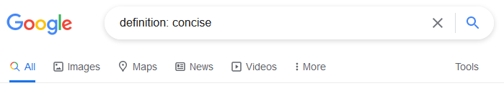

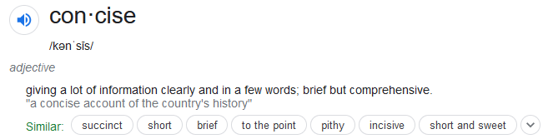
2. Conciseness:
Form your ideas in a simple and clear (but specific) way
Only include information that is necessary for the audience to understand you
Limit message content to no more than 3 ideas
If more ideas need to be shared, use an alternate communication method

Slide 30
3. Language: Tone
Be positive!
Even in negative situations, try to remain positive
Be honest:
Business relationships require trust - without honesty, there is no trust
Be realistic:
Set real expectations of what is actually possible
Do not set deadlines that you cannot meet, or are unreasonable for others to meet
Be respectful:
Other people have different cultural backgrounds or working environments
Other people have different needs or expectations
Understand your Audience:
Be aware that international audiences might interpret words/ideas differently

Slide 31
4. Language: Politeness
Your relationship with the audience should affect how you communicate:
Business depends on forming and maintaining working relationships:
Do not be rude and/or aggressive
Generally, use a friendly approach
If you know the receiver, it can be ok to be semi-formal
If you do not know the receiver, remain formal to appear professional
Be considerate when asking for things
Make requests, not demands
Please and Thank you help create and maintain a polite atmosphere

Slide 32
5. Communicative Obstacle: Lack of Accuracy
Common Errors:
Common grammatical issues such as singular/plural, verb tenses, articles, word order, prepositions, question formation
Use a dictionary:
Understand word definitions
Learn word families
Read example sentences
Be specific:
Use specific language with numbers, dates, places, names to avoid confusion
Remember: If your writing is not accurate, you will give a negative impression

Slide 33
Scenario 1- IT Helpdesk
Situation: An employee has reported a technical issue.
Hi. We've had several people say they can't log into the system today. We think it might be connected to yesterday's update, but we're not completely sure yet. Please check it whenever you have time because people are starting to ask about it and we'd like to get it fixed before more problems happen.
Discuss
Who is the audience?
What is the purpose?
Is the message clear?
What important information is missing?
Would this communication be effective? Why or why not?

Slide 34
Scenario 2- Customer Notice
Situation: A company needs to inform customers about a scheduled maintenance.
We are going to do some work on our system tomorrow. Some services may not work properly for a while. We hope everything will be finished quickly, but we can't say exactly when. Thank you for your understanding.
Discuss
Who is the audience?
What is the purpose?
Is the message clear?
What important information is missing?
Would this communication be effective? Why or why not?

Slide 35
Scenario 3- Project Team
Situation: A project leader is updating the team.
We are making good progress on the project, but there are still several things that need to be completed before the deadline. Everyone should continue working on their assigned tasks and try to finish everything as soon as possible. Let me know if there are any problems.
Discuss
Who is the audience?
What is the purpose?
Is the message clear?
What important information is missing?
Would this communication be effective? Why or why not?

Slide 36
Week 1 Summary
Before you communicate, always ask yourself the following:
Who is my audience?
What is my purpose?
What information does my audience need?
What language and tone should I use?
Which communication method is most appropriate?
Good business communication means delivering the right message to the right audience using the right language and communication method.

Slide 37
Homework: Improve a Business message
Choose one of the scenarios you considered before.
Rewrite the message to make it:
Clear
Concise
Professional
Appropriate for the audience
Grammatically accurate

Slide 38
Congratulations on surviving your 1st class
THANK YOU for your participation today
Have a great week everyone!
See you next week
Until then, Take Care & Stay Safe
Finally….

